Slide 1

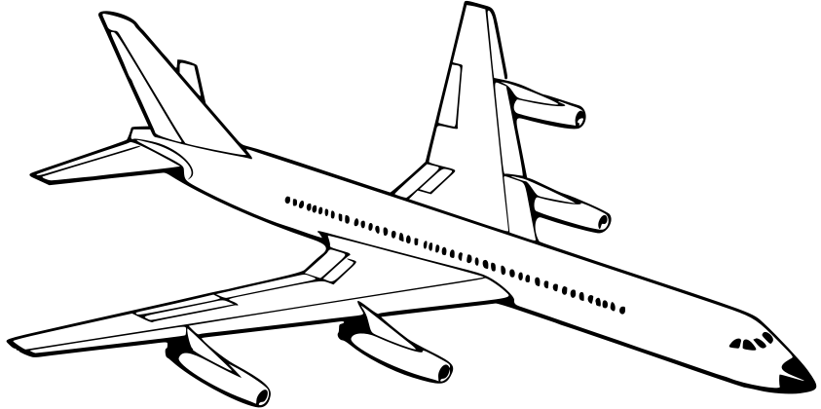

Airline Passenger Satisfaction
Presented by:
AHAD ALMUTAIRI
AS Project 1 of SDAIA data science Bootcamp (T5)

Slide 2
Outlines:
1
BACKSTORY
4
WORK FLOW
2
AIMS AND OBJECTIVES
5
CONCLUSION
3
TOOLS

Slide 3

BACKSTORY
One of the most important factors that concern airlines
is the customer and focus on the needs and requirements of the customer
to work on them and attract customers to them. The most important needs
of the customer are the ease of booking via the Internet,
food and beverage service, shipping bags and many other factors. In the data set

Slide 4

AIMS AND OBJECTIVES
Compare the best airline class for customers
Comparison of customer satisfaction with wi-fi
Comparing customer satisfaction by age
Compare who are most loyal to the airline

Slide 5





Tools

Slide 6













WORK FLOW
Compairing the preferred
class of travel from customers
Satisfaction rate of
people with airline
Uploding The airline passenger satisfaction survey dataset from kaggle.com
Extracting Are customers
satisfied
with the Online booking
Knowing the loyal customer
and disloyal customer
Data Cleaning

Slide 7
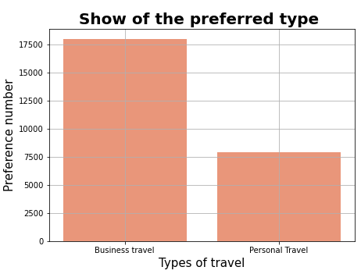
RESULTS
This graphic shows us that the most
preferred by customers is business class

Slide 8
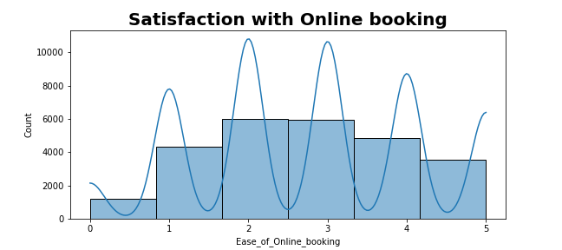
RESULTS
This graph shows us the degree of customer satisfaction with the wi-fi service, as 0 is not satisfied and 5 is very satisfied

Slide 9
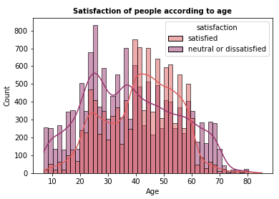
RESULTS
This graph shows satisfied customers and customers not satisfied with the airline's services by age

Slide 10
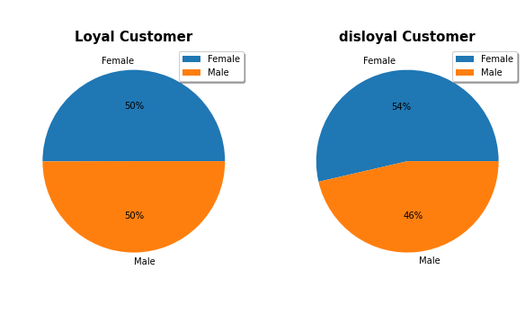
RESULTS
This chart show loyal customer and disloyal customer for the airline by gender

Slide 11
CONCLUSION
In conclusion my final result will help Airlines Attracting customers by improving their services and focusing on customers from the age group 20 to 45 years, as they represent the largest category of traveling customers

Slide 12

THANK YOU
for your kind attention

